Slide 1


Tokyo Airbnb – Executive Presentation
Date: October 3rd 2020
Presenter: Rick Takeuchi

Slide 2
Increasing overall revenue for Tokyo Airbnb by 40% requires either finding optimal neighborhoods for Airbnb bookings or discovering key variables that increase booking prices
!
Through the increased demand for Airbnb reservations, operational costs increased to host new listings. Too many listings in unideal areas will create potential deficits.
Problem 1:
Increased number of listings requires discovering ideal neighbourhoods for Airbnb development
!
People use Airbnb because of lower booking prices compared to hotels. Unfortunately, lower mean booking prices led to lower overall revenue. However, cost-effective listings can be used for budget travelers.
Problem 2:
Overly lower booking prices are detrimental to overall Airbnb regional revenues
!
Number of customers for Airbnb visits are highly impacted by previous customers’ reviews. If reviews are lower, smaller number of customers and potentially lower booking prices will make Airbnb unsuitable both in short and long term.
Problem 3
Lower review scores will lead to less customers and revenues in the future

Slide 3
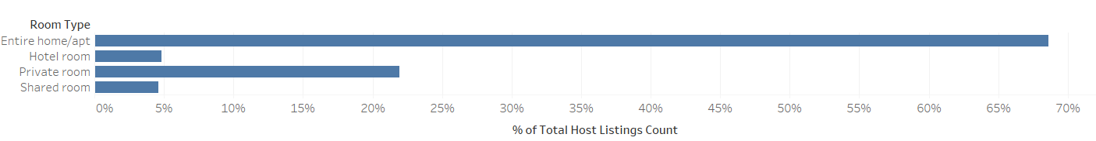
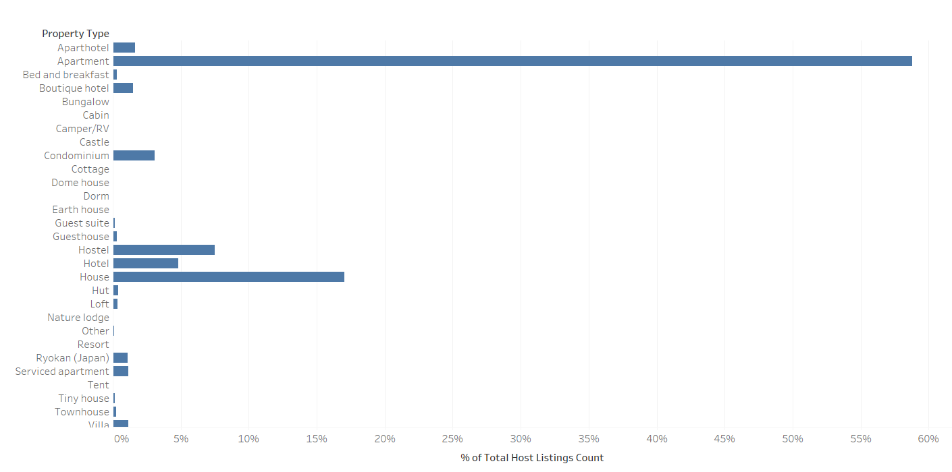
The large percentages of listing rentals are entire home/apt (68.6%) largely consisting of apartments (58.78%) and houses (17.06%). To generate higher revenue margin based on listing numbers, more house and apartment reservations consisting of entire homes is required.
Source: Southern Water Corp Financial Records (SAP) 2013-2015
Source: Open Water Market Data (2013 – 2015)

Slide 4
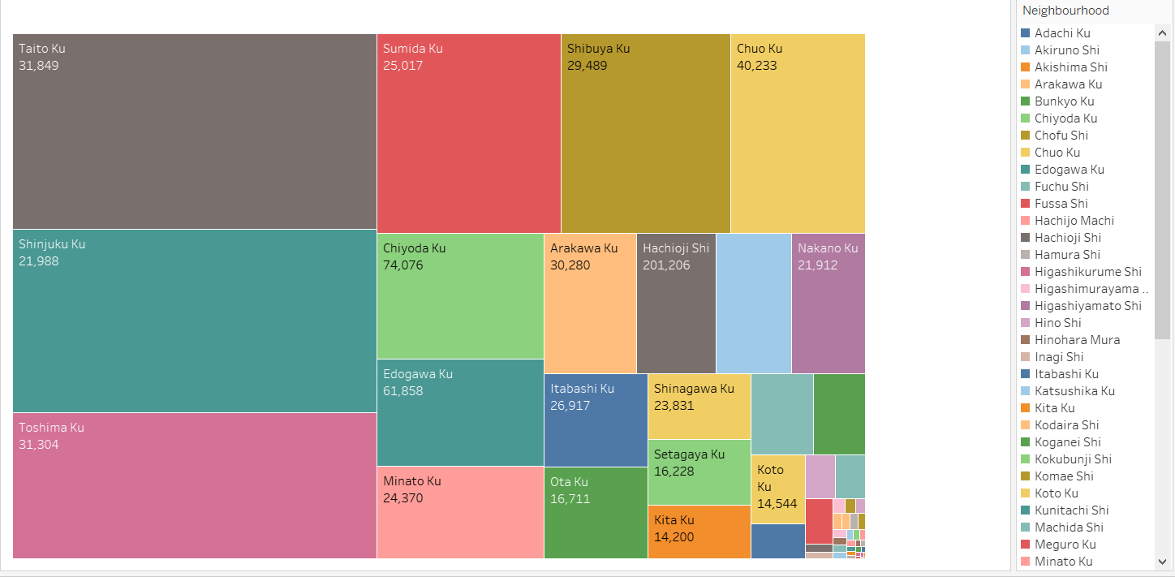
Observing the Square chart, it would make sense that Airbnb should invest more in the top 9 neighborhoods primarily because they contain majority of the listings.
Key Insights
Each square is based on portion of listings of each neighborhoods and mean price.
Taito Ku and Toshima Ku should be prioritized due to relatively higher mean listing price and proportion of listings in Tokyo.
Seven other neighborhoods should be prioritized for development in the following order: Shinjuku Ku, Chuo Ku, Shibuya Ku, Sumida Ku, Chiyoda Ku, Edogawa Ku, and Minato Ku
¹ EBIT is calculated as Revenues – COGS – Operational Expenses
Source: Financial and operational data from Exemplar
Notes:
Leverage EBIT slide, then flow into Revenue, COGS and Operational Expenses

Slide 5
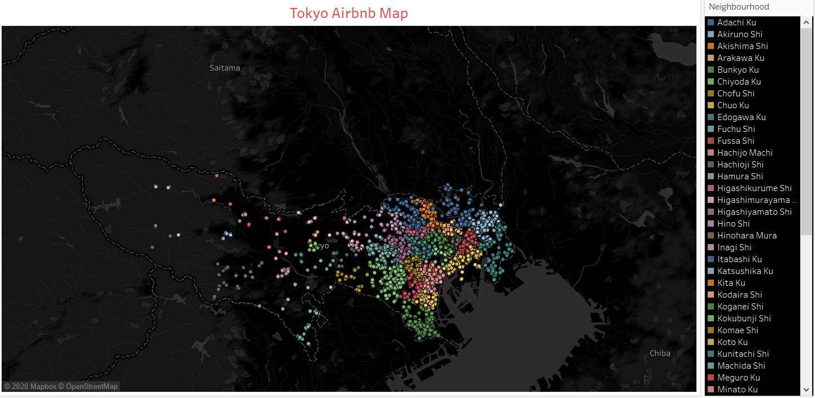
Since neighborhoods with most listings are mostly located in Central Tokyo (Special Wards of Tokyo), Airbnb must invest more listings and market these regions due to higher level of tourism and business.
Key Insights
Taito Ku (grey), Shinjuku Ku (turquoise), Toshima Ku (light purple), Sumida Ku (red), Shibuya Ku (dark yellow), Chuo Ku (light yellow), Chiyoda Ku (light green), Edogawa Ku (turquoise dots in very east), and Minato Ku (pink) are located in metropolitan Tokyo.
Most listings are located in Central Tokyo due to highest level of business activities and tourism. Also, these regions are most accessible to non-Japanese speakers.

Slide 6
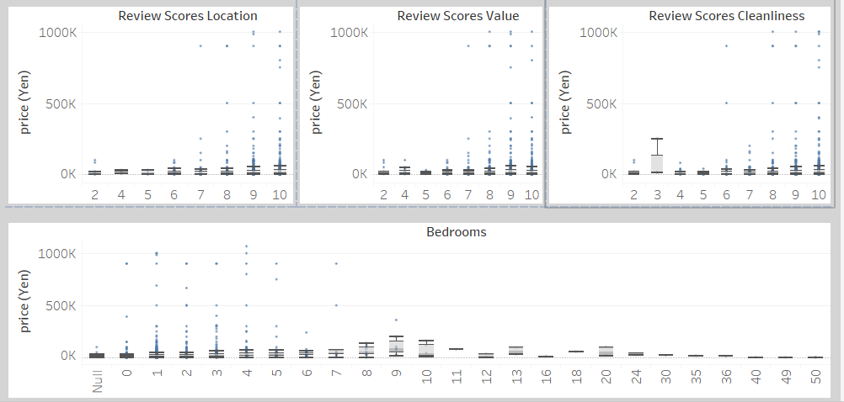
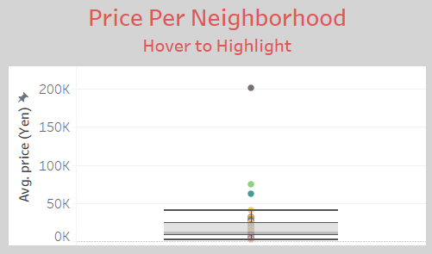
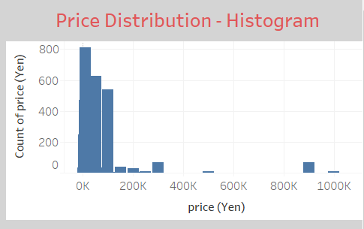
Having a higher number of bedrooms or higher review score does not strongly contribute to the listing price. However insights of skew of listing prices and most expensive neighborhoods are discovered.
Key Insights
Price of the listing is compared to reviews of location, value, and cleanliness of the location. While, the another chart compares bedroom numbers to listing prices.
Since most of the listings are under 200,000 yen, the listing prices are strongly right skewed.
Neighborhoods with highest average listing prices are Chiyoda Ku,Hachioji Shi, Edogawa Ku, and Chuo Ku. These neighborhoods are great sources of potential listing and income due to proximity to Central Tokyo and large number of listing in these neighborhoods.
¹ EBIT is calculated as Revenues – COGS – Operational Expenses
Source: Financial and operational data from Exemplar
Notes:
Leverage EBIT slide, then flow into Revenue, COGS and Operational Expenses

Slide 7
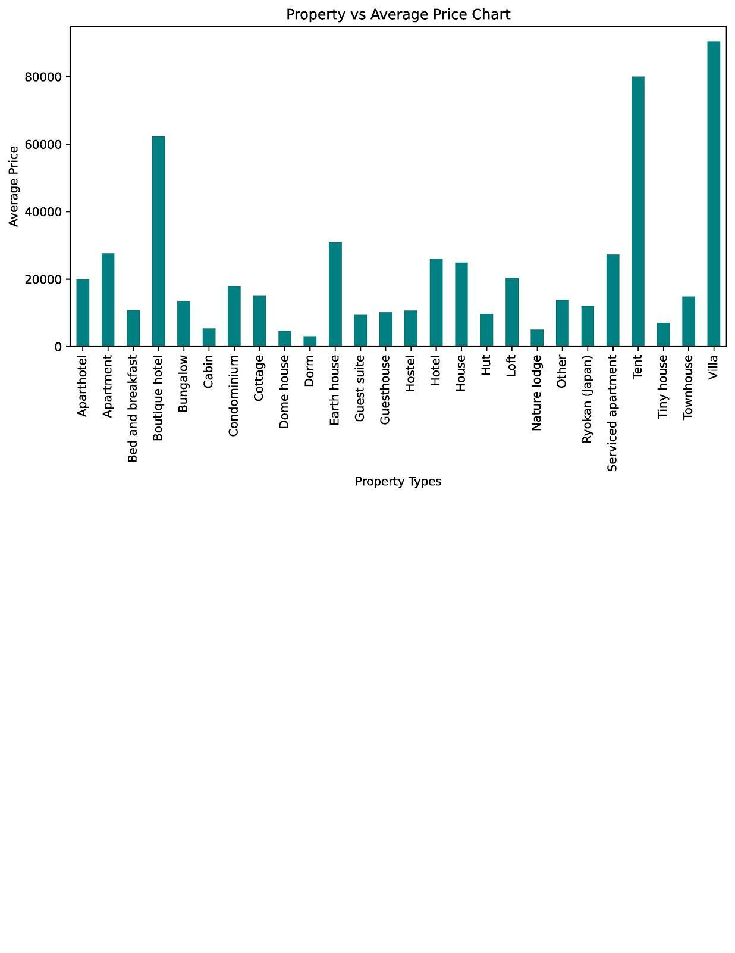
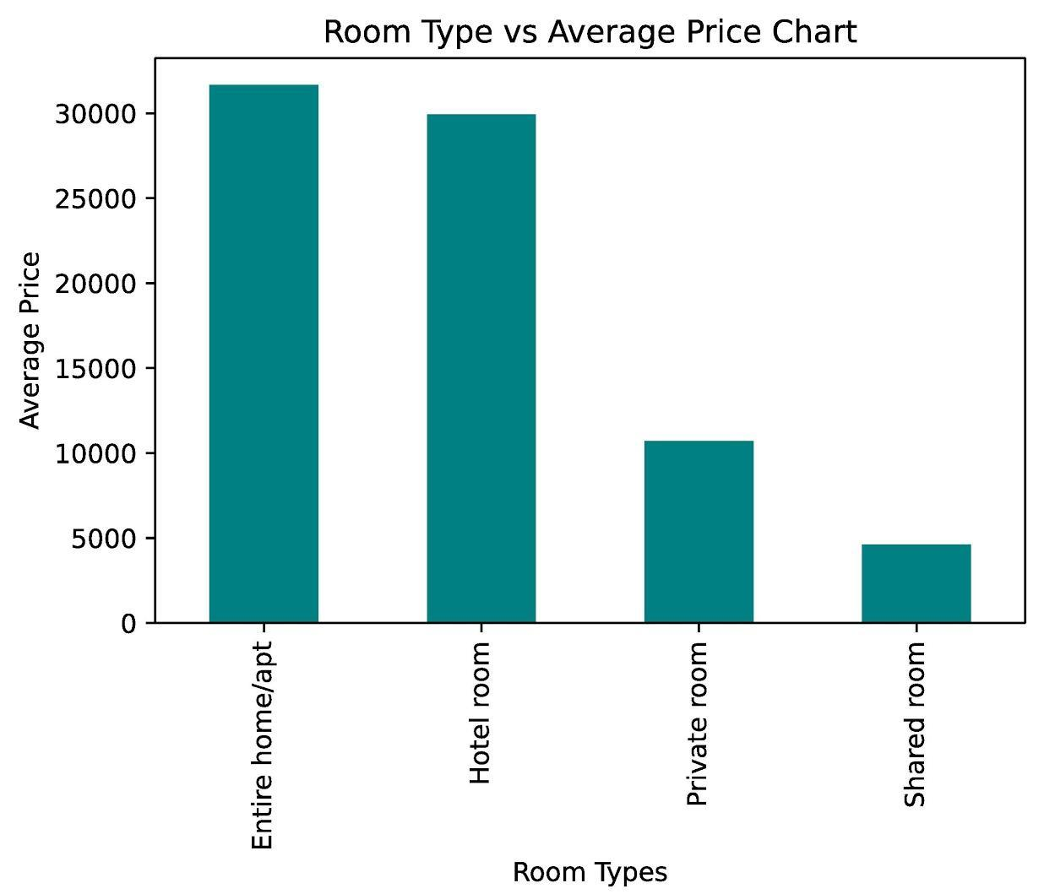
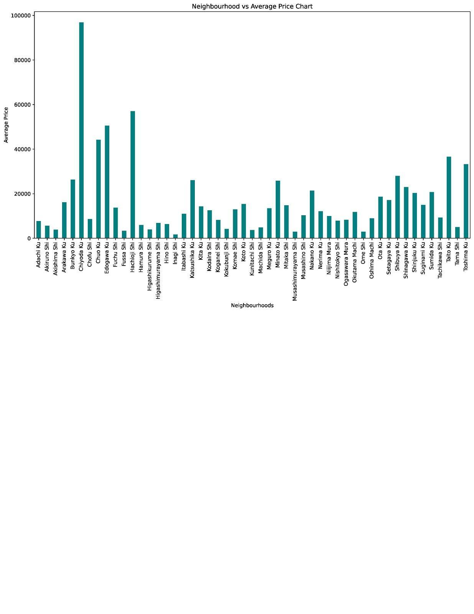
With highest proportion of listings and highest average price, Airbnb must rent out entire homes/apt (30K Yen) to generate higher revenue margin and increase number of new potential listings.
Key Insights
High occupancy rates in lowest price neighborhoods and/or property types can generate revenue if Airbnb caters these listings to low budget travelers and student travelers.
Most expensive property types can only generate large revenues if someone is interested in investing or renting these types of properties.
.

Slide 8
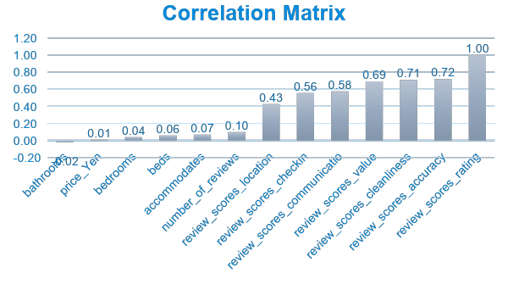
Further analysis of the dataset where the Airbnb listing reviews yielded three (3) key signals that strongly correlated with overall reviews which boosted our confidence in the trend picked up in descriptive analysis.
Key Insights
Through utilizing a measure known as correlation which indicates how closely a variable is associated with “Overall reviews” (AKA review_scores_rating), we were able to identify three (3) key variables customers pay most attention to. A correlation score is is returned with number closer to 1, indicating the variable is closely related to overall reviews. However, “Overall reviews” have solid correlation with three review subcategories in particular.
Accuracy: 0.72
Cleanliness: 0.71
Value: 0.69

Slide 9
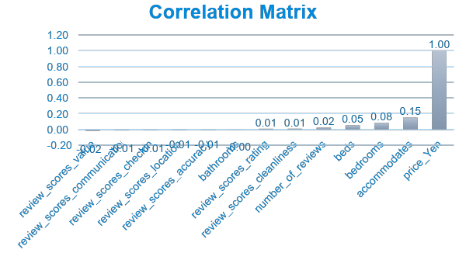
Further correlation analysis for listing price with other variables yielded no variables that are strongly correlated with property price, which reduced our confidence in finding quantitative variables related to listing price
Key Insights
Through utilizing correlation again with listing price (price_yen), there were no variables that strongly correlated with listing price of Airbnb properties. A correlation score is is returned with number closer to 0, indicating the variable has little or no correlation with listing price. However, listing price have small correlation with three review subcategories in particular.
Accommodates: 0.15
Bedrooms: 0.08
Beds: 0.05

